Slide 2

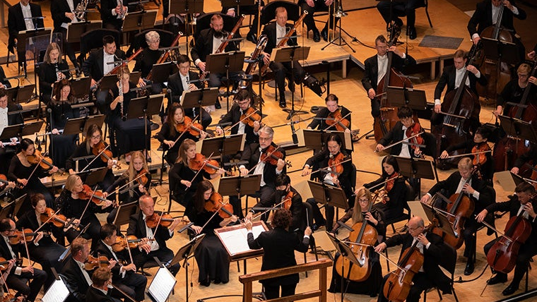
Atlanta Symphony Orchestra
Data Analysis and Recommendations
Briana, Gaby, Geoff, Jiwon, Swarali

Slide 3
Agenda
Presentation Objective: To provide preliminary insights and trends from data about ASO
  Audience Behavior
  Revenue generators
  Subscriber Movement
  Demand Curves
  Pricing Simulations

Slide 4
Audience Behavior
A breakdown of single ticket buyer vs. subscriber purchasing behavior and attendance.

Slide 5
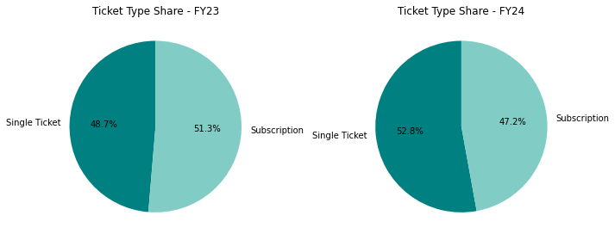
Subscribers vs Single Ticket Buyers
Ticket Type Summary Table
Fiscal Year | Single Ticket Buyer Counts | Subscriber Counts | Total
FY23 | 15,772 | 16,633 | 32,405
FY24 | 18,568 | 16,566 | 35,134
From FY23 to FY24, the number of single-ticket buyers increases by 2796, while number of subscribers decreases by 67.
Notes:
Where the increase in single ticket buyer came from?
Where did this increase focused on (by event, or other factor of relevant)

Slide 6
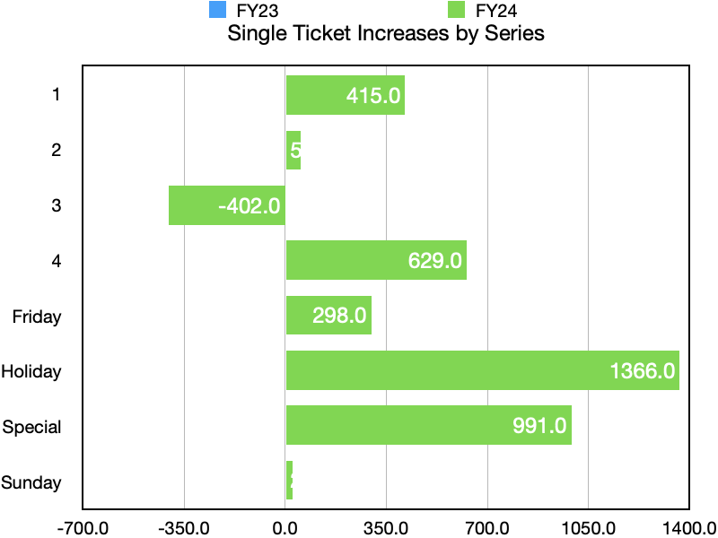
Huge increases in ticket count for FY24 for Holiday, Special and Delta Series 4.
Notes:
This chart reflects the increase of tickets in FY24 compared to FY23, hence why FY23 isn't depicted on the chart.

Slide 7
Single Ticket Buyer Behavior

Slide 8
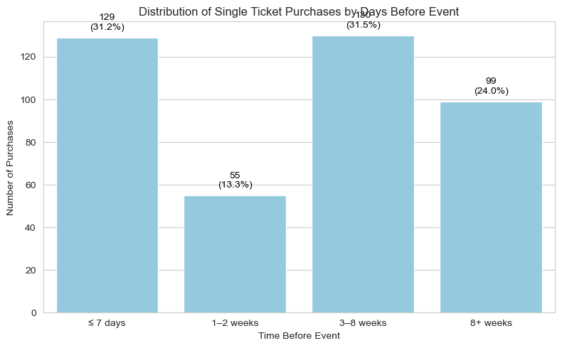
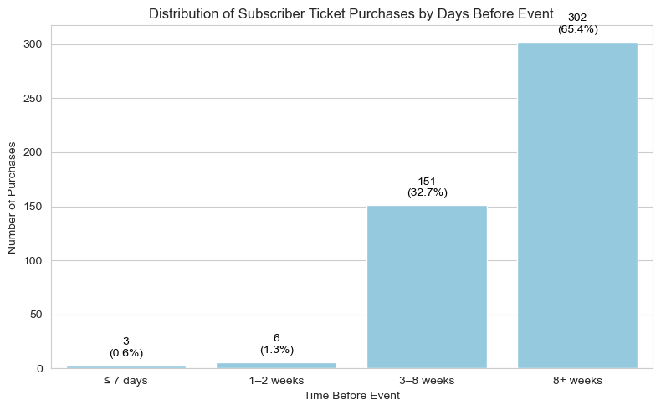
Single ticket purchases by Days before Event
On average, subscribers reserve their tickets over 2 months in advance
In comparison, this is much farther out than single ticket purchasers who buy about 2-3 weeks out in advance
Notes:
At some point, make sure to include in our final presentation, to achieve the most effective way to show the contrast between single-ticket buyers and subscribers.

Slide 9
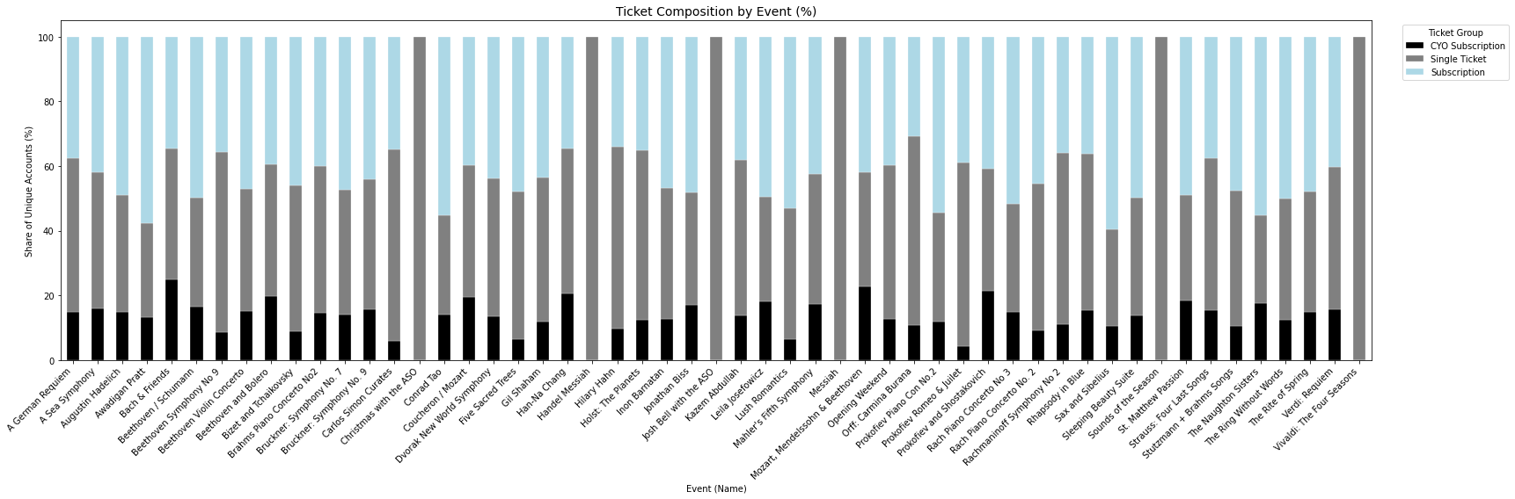
Share of Ticket Groups Across Events
Steady fraction of subscribers in each event, but a lot of fluctuation in single-ticket users per event, indicating the kind of program matters to single ticket buyers.
CYO representation is not small, it's significant. It contributes to fluctuation, indicating there are some shows they like more than others.
Notes:
Combine them. Three major categories, CYO, subscribers, and single-tickets and the proportion of single-ticket purchases, subscribers, etc. In each event across time, so this is a good graph. It shows steady fraction of subscribers in each event, but a lot of fluctuation in single-ticket users per event, indicating the kind of program matters to single ticket buyers. THAT is what you should focus on for this slide.
Give CYO group is growing, CYO representation is not small, it's significant. And it contributes to fluctuation, and there are shows they like more than others, so there's something to be gleaned about CYO here in this slide.

Slide 10
Subscriber Behavior

Slide 11
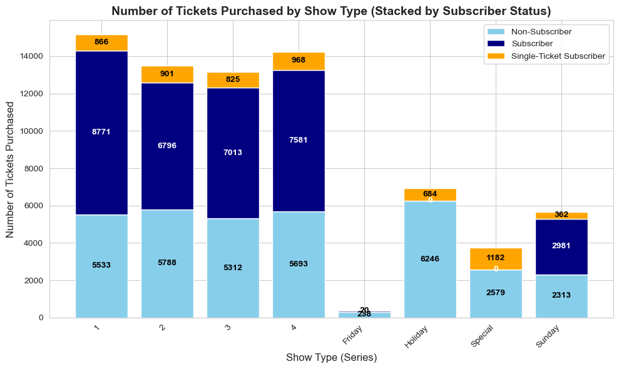
Tickets purchased by Series and Buyer type
57% of all subscribers bought at least one single ticket

Slide 12
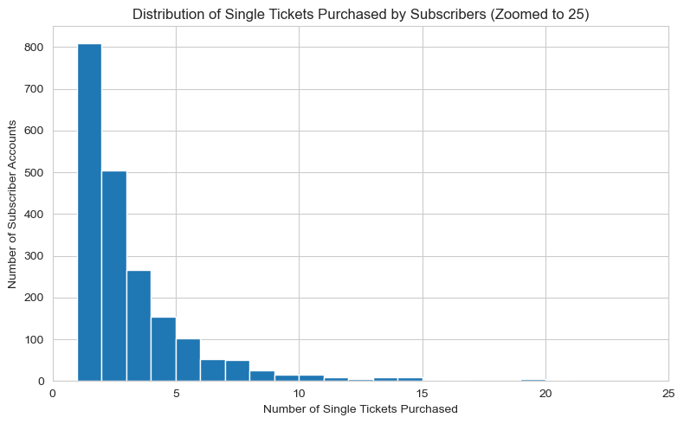
Tickets purchased by Series and Buyer type
Notes:
Explain more what this means? If they don't buy 24, they have missing shows. Is the extra add-on outside of their given series, or is it a special? Is it a Holiday show? What is the most popular shows/types of programs that these people buy most frequently for add-ons? Do it by the number of add-ons bought. For those who purchase 1 add-on, what's the most popular events? For those who purchase 2+ add-ons, what are the most popular events? (Create two graphs for this, for one add-on subscribers, and 2+ add-on subscribers)

Slide 13
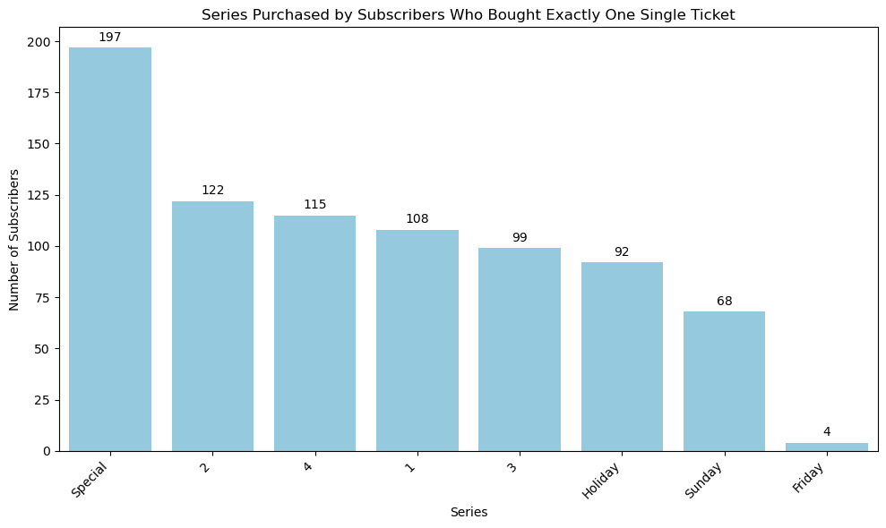
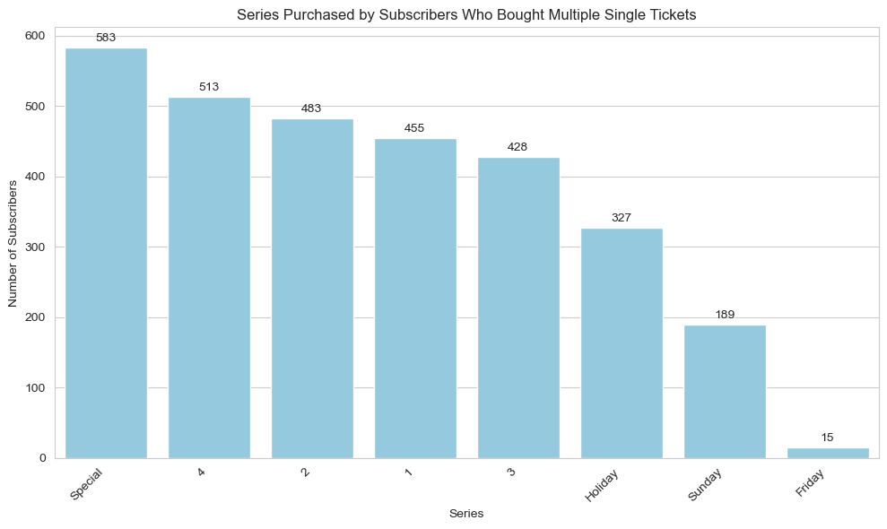
Tickets purchased by Series and Buyer type
Notes:
Most popular events for exactly one single ticket: Josh bell (413), Vivaldi (241 &215), Beethoven Symphony No. 9(82,79,71) and Hilary Hahn (78)
Most popular events for multiple single tickets: Josh bell (438), Vivaldi (293 & 254), Beethoven and Bolero (86), Messiah (86), Beethoven Symphony No. 9(84,72,21)

Slide 14
Key Observations & Potential Recommendations
Holiday and special programs have no subscriber participation; opportunity for special pricing for subscribers
On average, a subscriber purchases 4 add-ons (4 single tickets for shows); 57% of subscribers purchased at least one add-on in FY23 and FY24
  Premium program for subscriber purchases of add-ons
For single-ticket buyers the median of single-ticket buyers buy their ticket 17 days before vs subscribers who buy their tickets 2 months in advance
  Spread awareness through social media – Instagram, Tik-Tok
  Early bird booking offers
  Personalized recommendations (via email)
Notes:
Be careful with discounts, it's not that they're not attending, it's likely not because of the price. So only those who are very price-sensitive, we offer discount, but not to people who are price inelastic. So we have to find different ways. How many of them are still attending holiday and special programs, and if they are price inelastic, can we come up with some bundling, that comes with regular programming and special/holiday programming, where they can pay in advance/choose their seat/etc. Then can we charge an extra premium on this? (New product bundle that comes with current membership, with added premium for holiday/special to secure a seat in advance)
We also want to have a strategy to encourage subscription upgrade (using our reasoning with the add-ons), without losing out on revenues

Slide 15
Revenue Generators
Analysis on revenue sources by events and subscriptions/single tickets.

Slide 16
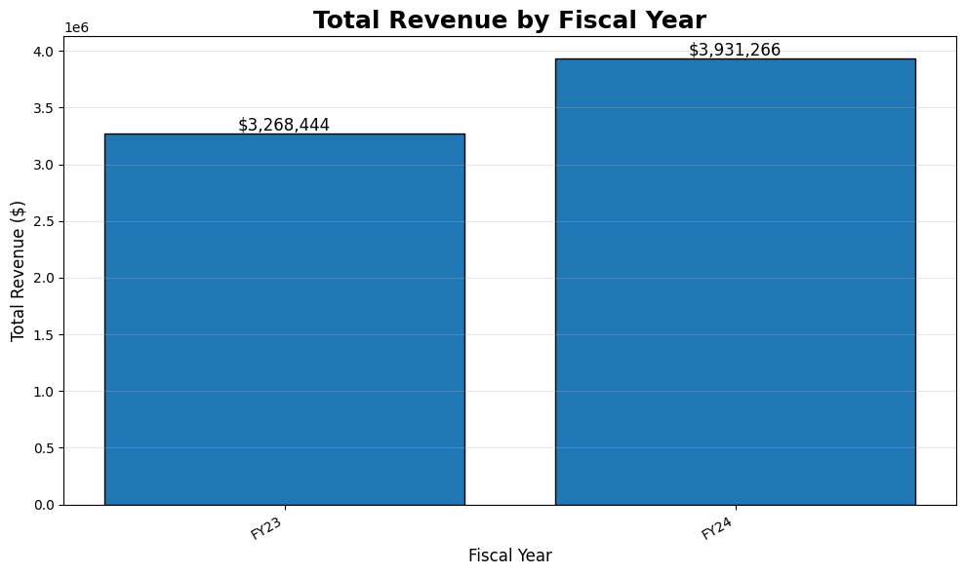
Revenue by Fiscal Year
in millions

Slide 17
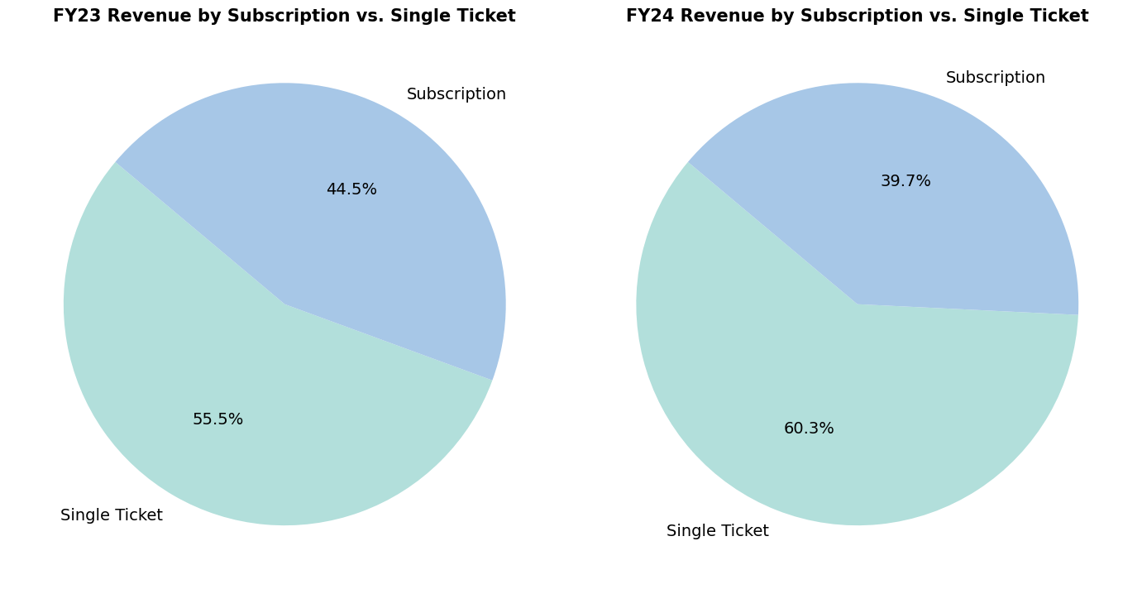
Revenue by Subscription vs. Single Ticket Buyers per Fiscal Year

Slide 18
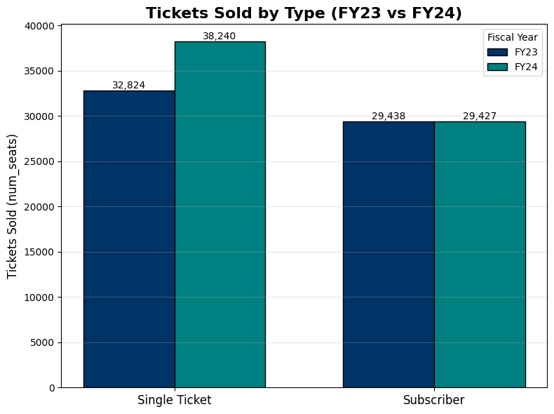
Ticket Purchases for Subscribers vs. Single Ticket Buyers
** Revenue increase in 2024 can be attributed to increase in single ticket purchases.
Notes:
Important note: it's not the number of unique single ticket buyers or unique subscribers, it's the number of single tickets purchased, and the number of tickets purchased as part of a subscription by a subscriber
We see here that the number of tickets bought by subscribers remain almost exactly the same between FY23 and FY24, but single ticket purchases go up by nearly 6,000.

Slide 19
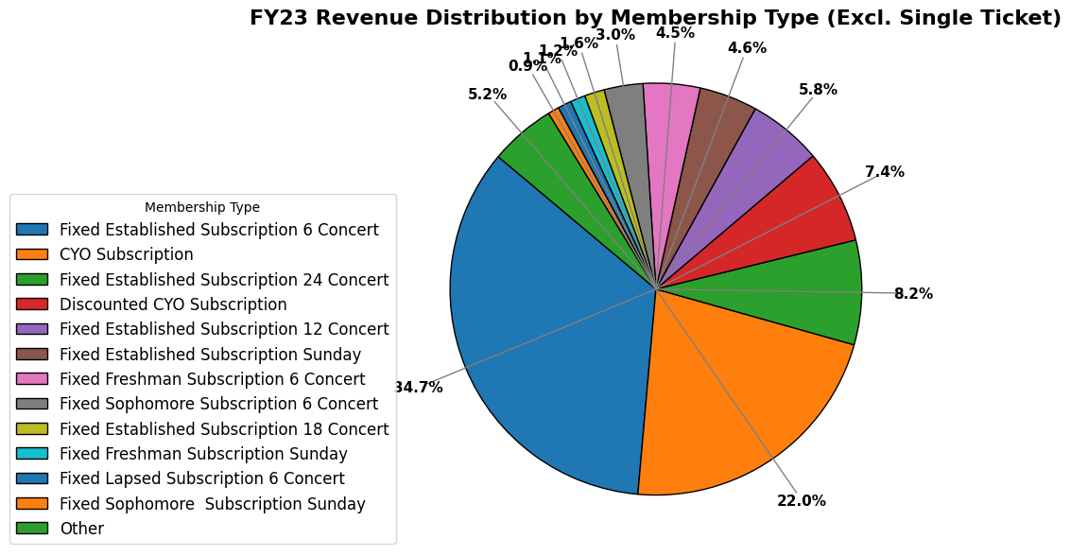
Breakdown of Revenue by Membership FY23

Slide 20
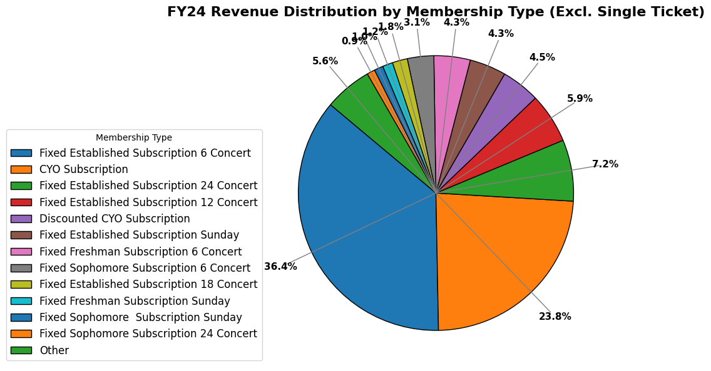
Breakdown of Revenue by Membership FY24
Notes:
Very interesting—CYO subscribers make a smaller share of the different kinds of subscription types at ASO, but contribute to the second largest share of total revenue in both FY24 and FY23. Considering this, we can take a deeper dive into why this might be the case.

Slide 21
Breakdown of Revenue from CYO
Ticket Price Summary (All Members Excluding CYO)
Minimum Ticket Price | Average Ticket Price | Maximum Ticket Price
$0.00 | $39.48 | $107.75
Ticket Price Summary (CYO Subscription Only)
Minimum Ticket Price | Average Ticket Price | Maximum Ticket Price
$22.00 | $67.96 | $124.00
Ticket Price Summary (All Members + Single Tickets)
Minimum Ticket Price | Average Ticket Price | Maximum Ticket Price
$0.00 | $51.08 | $275.00
Ticket Price Summary (Single Tickets Only)
Minimum Ticket Price | Average Ticket Price | Maximum Ticket Price
$5.00 | $59.86 | $275.00
Notes:
The last one just the single tickets only, for CYO instead of staying as single ticket purchase users do they get better. She wants to see wether single ticket users are paying a lot more than CYO program but they don't know yet because they have too many prices and they don’t know how to advertise it. So third table needs to be different.
For subscribers if they bought 6, 12, 18, 23 among them how many of them bought extra ticket (1,2 or 3). What she wants to know is how many of them actually buy, if I plan to buy 6, then 6 is the right number to buy, but some of those people buy 12 but only attend 6. so she wants to see the mismatch.

Slide 22
Key Observations
Revenue distributions for membership types, seasons, seat sections, and event types generally remains the consistent across FY23 and FY24.
CYO makes up 13.73% of members, but 22-23.8% of revenue.
  Significantly higher average price
  Common failure to renew CYO subscription in the next year
Thus, high potential for revenue from CYO subscribers.

Slide 23
Subscriber Movement and CYO Subscribers
Analysis on subscriber movement throughout FY23 and FY24.

Slide 24
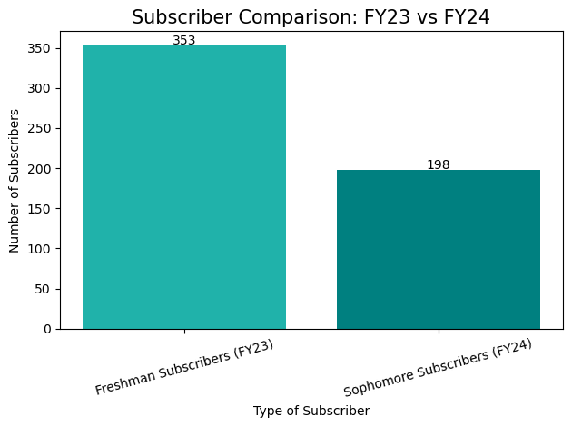
From 2023 to 2024, 56.1% of Freshman Subscribers renewed their subscription
Notes:
We start by looking at the retention rate of Freshman subscribers in 2023 that continue on as Sophomore subscribers in 2024. 56.1% of freshman subscribers stay in 2024 as sophomore subscribers. When we think about the 155 subscribers who don’t continue as sophomore subscriber, we want to take a look at whether they are still connected to the ASO by any means

Slide 25
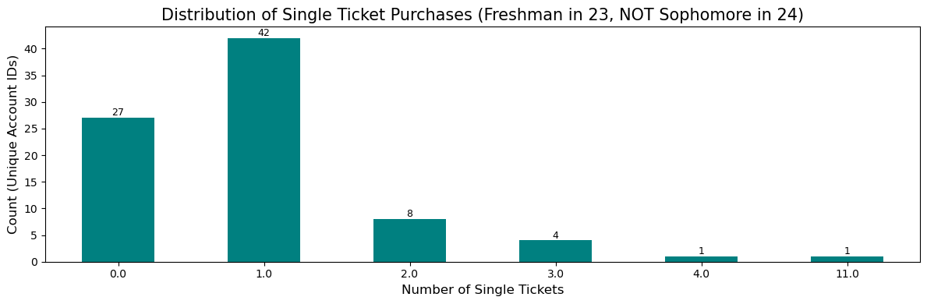
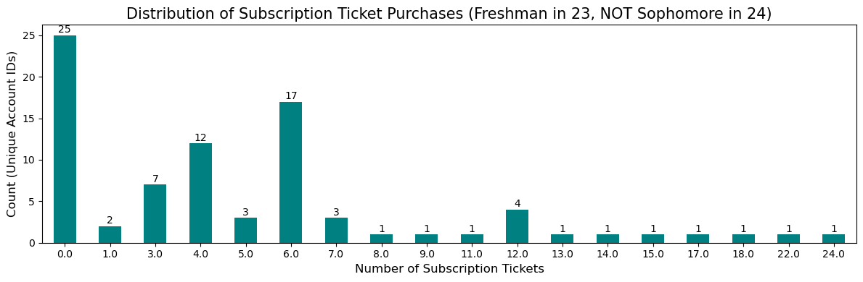
72 Freshman subscribers in 2023 do NOT return in 2024
All 25 accounts that weren’t subscribers, purchased 1 or more single tickets
Notes:
Here we see that 83 people came back as subscribers of some sort, just not sophomore subscribers. And even those 25 accounts who weren’t fixed subscribers, they all at least purchased one single ticket, they are still connected to the ASO in some way. 72, or just over 20%, of the Freshman subscribers in 2023 left the ASO in 2024.
Interpretation: these subscribers become CYO

Slide 26
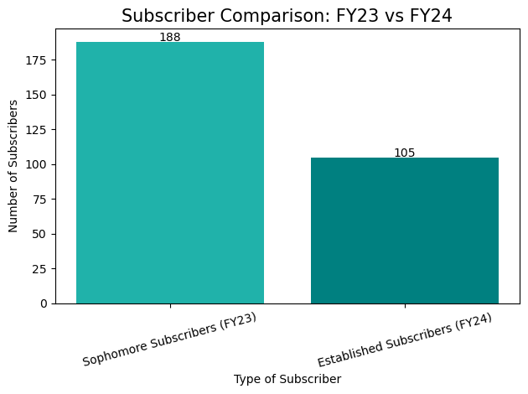
From 2023 to 2024, <80% of Sophomore Subscribers renewed their subscription
*By unique account id’s
Notes:
We continue by looking at Sophomore subscribers in 2023 that continue on as Established subscribers in 2024. 55.85% of sophomore subscribers stay in 2024 as established subscribers. When we think about the 83 subscribers who don’t continue as an established subscriber, we look at their consumptions in 2024 once more.

Slide 27
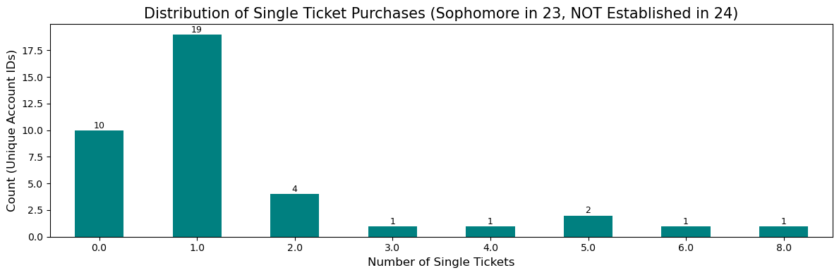
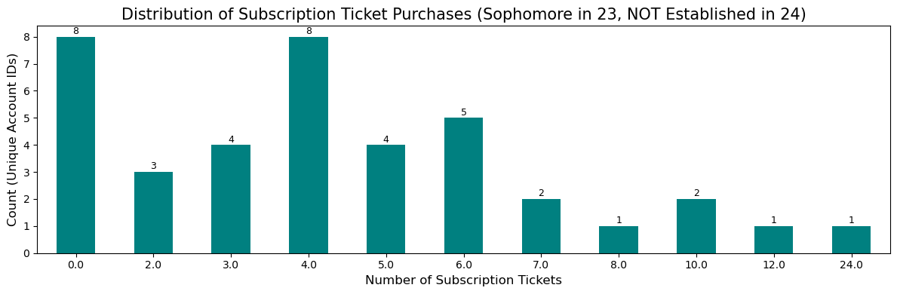
44 Sophomore subscribers in 2023 do NOT return in 2024
All 8 accounts that weren’t subscribers, purchased 1 or more single tickets
Notes:
39 sophomore subscribers come back as subscribers as some sort. And even the 8 unique accounts that aren’t subscribers of some sort in 2024, still purchased at least one single ticket.
44, or just over 23% of sophomore subscribers don’t return to the ASO in 2024.

Slide 28
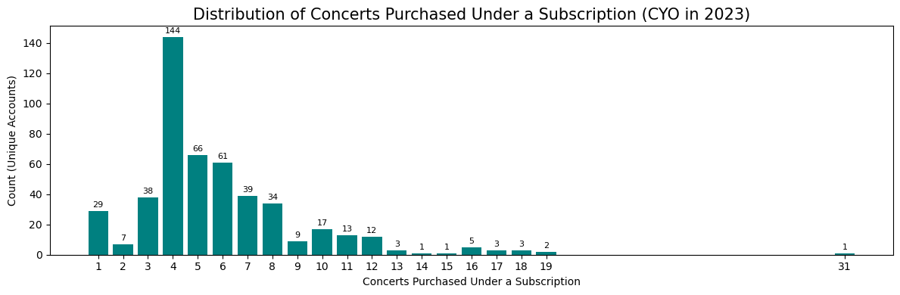
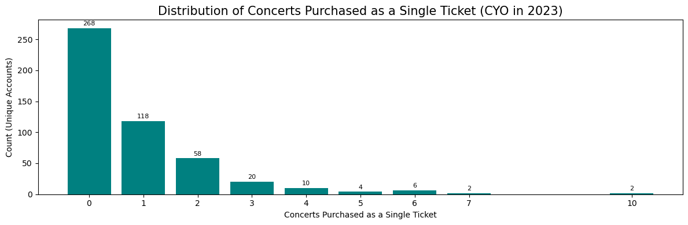
Consumption Patterns for CYO in 2023
Notes:
When we take a step back from the fixed subscribers, we want to take a closer look at CYO subscribers and their consumption patterns in 2023 and 2024. On this slide we take a look at CYO subscribers in 2023 and how many subscription tickets and single tickets were purchased. We see a peak at 4 tickets purchased in the subscription and even though the peak of single tickets purchased is 0 single tickets, a decent majority of CYO subscribers are purchasing 1 additional single ticket on top of their subscription.
(Outlier removed in the single ticket graph of 260 single tickets purchased ) (idk if you need to mention this)

Slide 29
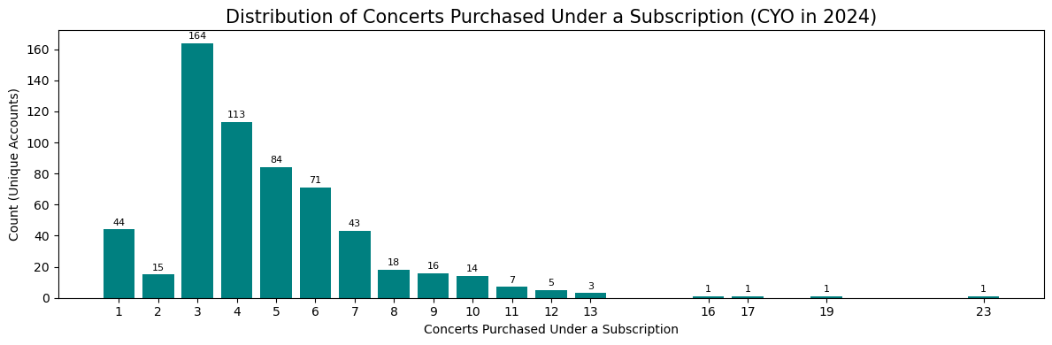
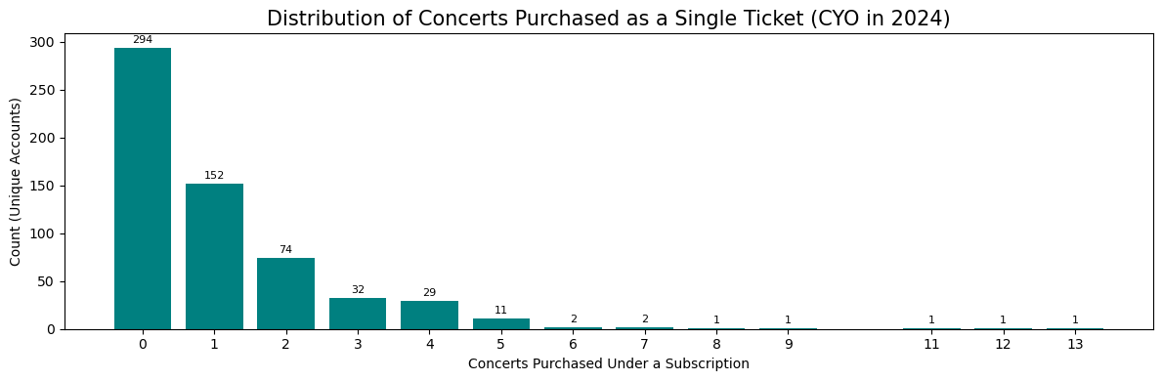

Consumption Patterns for CYO in 2024
Notes:
On this slide we take a look at CYO subscribers in 2024. We see a peak at 3 tickets purchased in the subscription and again, even though the peak of single tickets purchased is 0 single tickets, a decent majority of CYO subscribers are purchasing 1 additional single ticket on top of their subscription.
In both 2023 and 2024, CYO subscribers are purchasing 3-4 tickets as part of their subscription more frequently, and a majority of subscribers are also purchasing an additional single ticket.

Slide 30
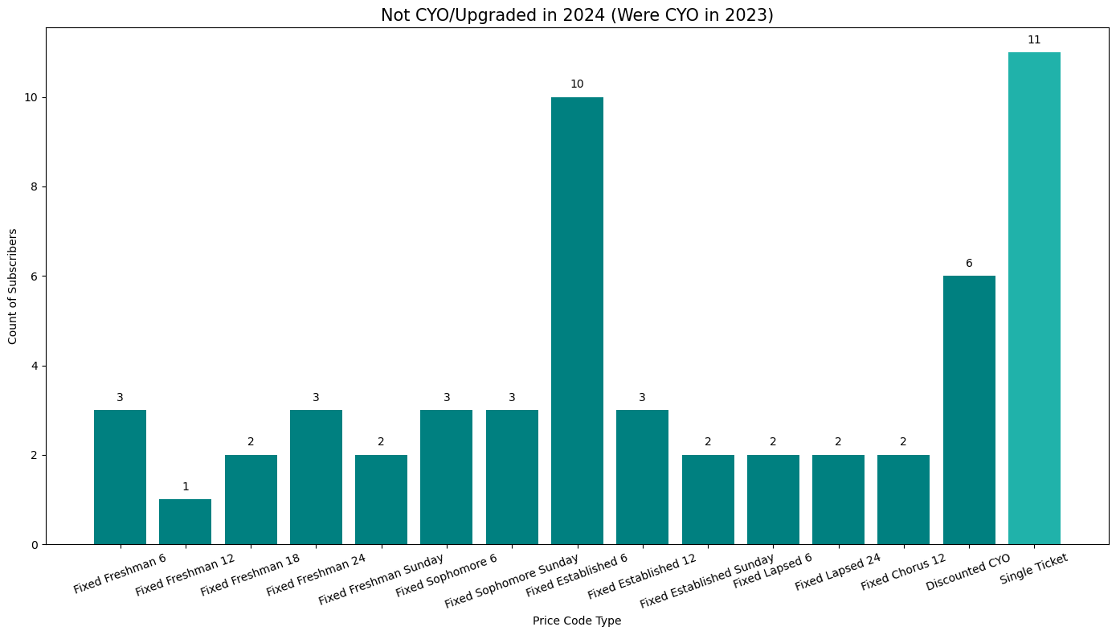
161 CYO subscribers in 2023 do NOT return in 2024
Notes:
For those CYO subscribers in 2023, who do not continue to be CYO subscribers in 2024, the majority of them seem to switch their subscription to a different type. 11 unique accounts continued to attend ASO events by buying single tickets. When we think about CYO retention rate between the years, it’s quite small, even though CYO subscribers gross such a big portion of the profit in both years.
(switch slides)
Therefore we have created some potential recommendations to combat the lower retention rate and maybe get CYO subscribers a few more perks.

Slide 31
Potential Recommendations
Advertise more to current CYO subscribers
  CYO Subscribers peak at 4 concerts – offer a marginal discount for the 5th concert in their subscription
  Offer first pick at seats for holiday series when purchasing a single ticket (as a thank you for being a subscriber)
Increase number of CYO subscribers, or tickets purchased by CYO subscribers
  For example, advertising CYO to fixed subscribers who do NOT attend all shows they purchase for the following year
  A majority of CYO subscribers purchase (at least) one add-on. Charging extra premium can possibly attract more CYO subscribers seeking flexibility for more shows and increase revenue generated from CYO ticket purchases.
Notes:
Therefore we have created some potential recommendations to combat the lower retention rate and maybe award CYO subscribers a few more perks, since they are paying more per ticket than regular fixed subscribers.

Slide 32
Demand Curves
Demand curves by seat section, subscription type, and event type.
Notes:
Make sure price is on y-axis and quantity is on x-axis

Slide 33
Demand by Seat Section

Slide 34
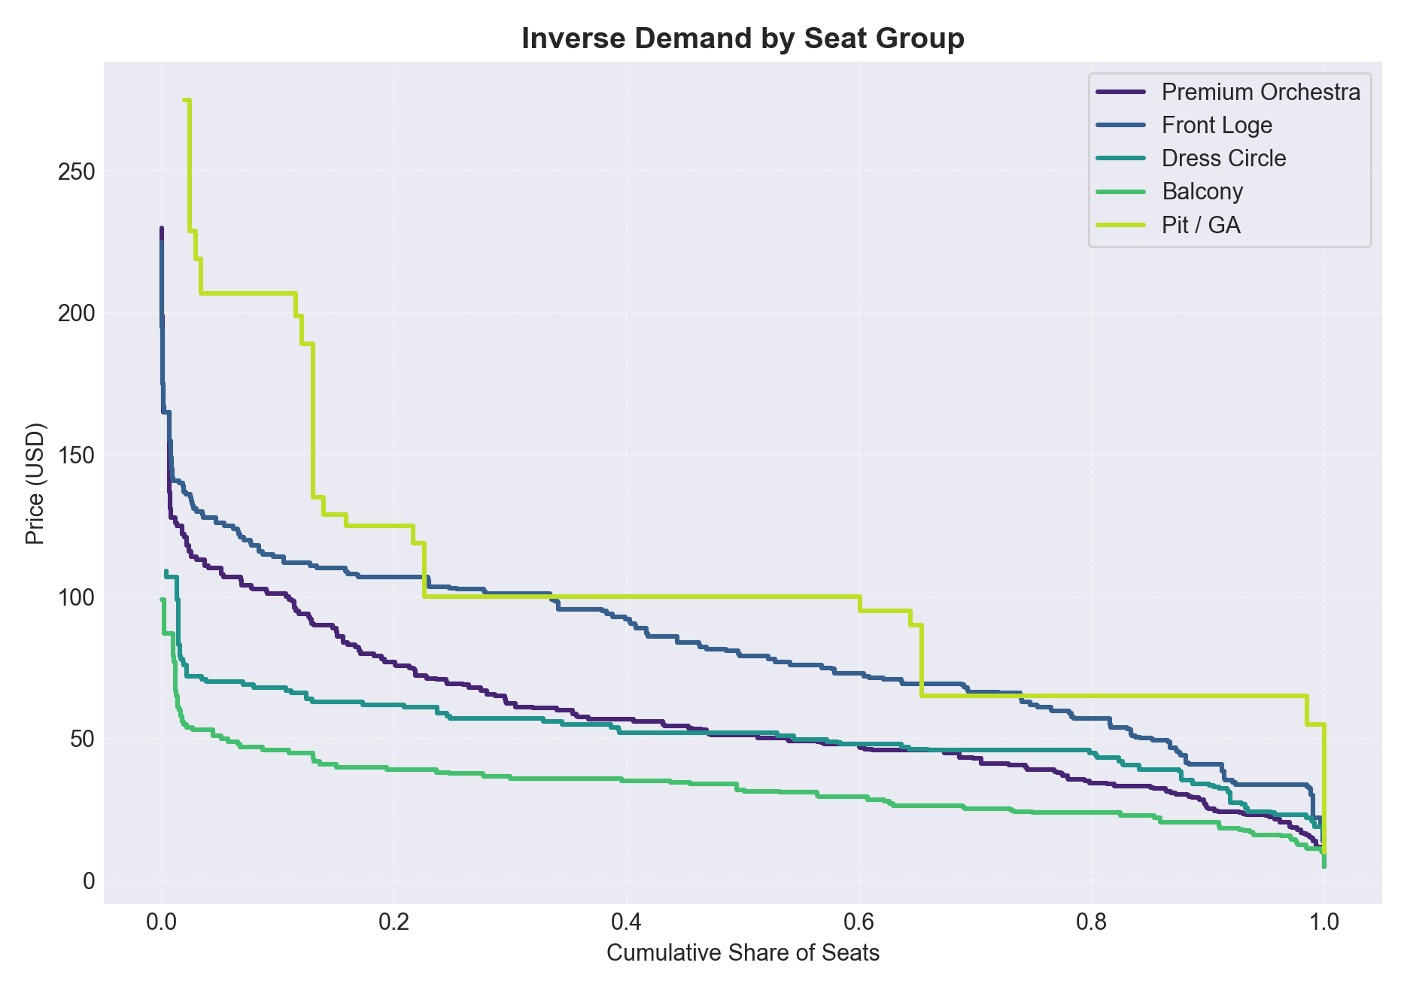
Demand by Seat Section
Notes:
Premium Orchestra & Front Loge (inverse_demand_seatgroup_premium_orchestra.*, ...front_loge.*): highest willingness to pay; curves stay above \$80–\$90 before tapering. Demand drops slowly with price, so modest increases (≤7%) barely impact volume.
Dress Circle (inverse_demand_seatgroup_dress_circle.*): mid-tier elasticity. Prices sustain through \$60 before a steeper decline; good candidate for weekend surcharges while keeping weekdays flat.
Balcony (inverse_demand_seatgroup_balcony.*): strongly elastic below \$40. Demand collapses quickly once prices exceed \$45, so keep entry pricing low and use targeted discounts for <35 buyers.
Pit/GA (inverse_demand_seatgroup_pit__ga.*): sparse data and high variance; treat insights as directional only.

Slide 35
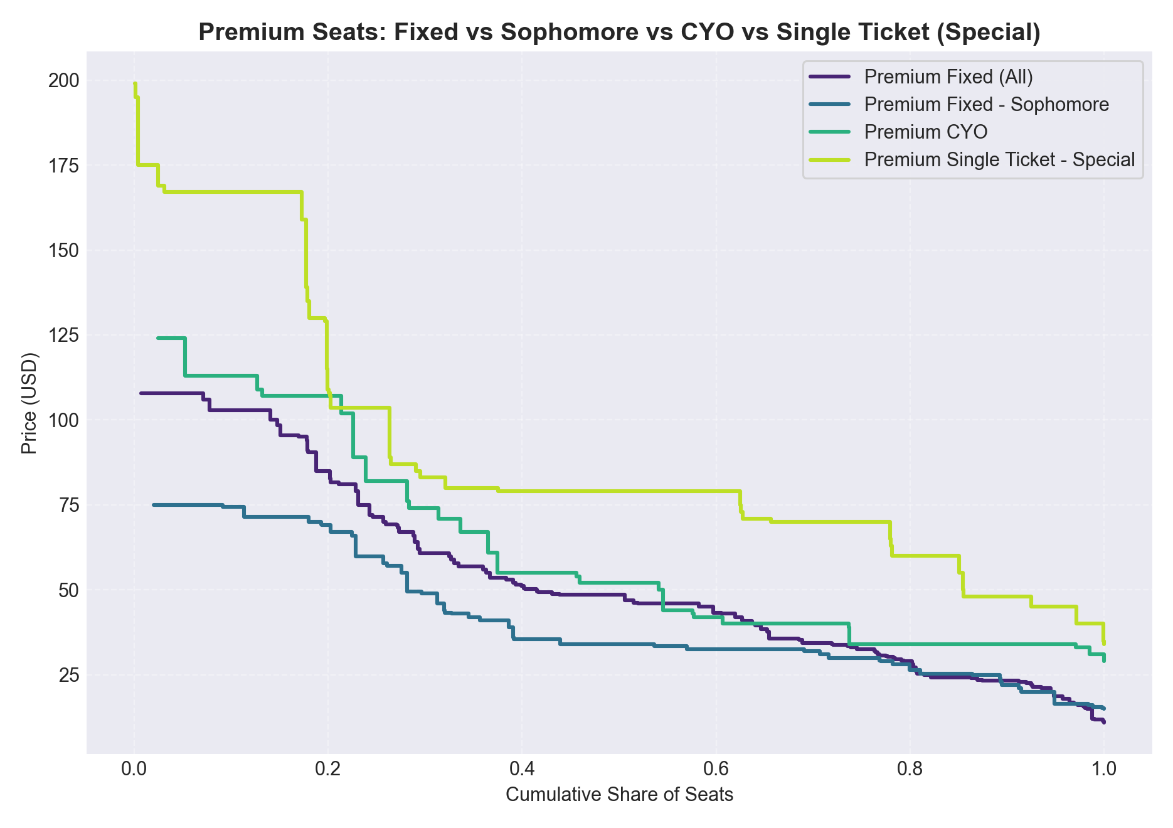
Demand for Premium Seats by Ticket Buyer
Notes:
Single Tickets (all) (inverse_demand_single_ticket_(all).*): average price ~$59 with moderate elasticity; demand softens when pushing above \$80.
Subscriber Single-Ticket Buyers vs Non-Subscribers (inverse_demand_special_single_ticket_accounts_overlay.png):
Subscriber accounts rarely exceed \$200; their curve is steeper, showing clear price tiers (~\$160, \$100, \$75). They value access more than dynamic pricing.
Non-subscriber accounts spread across a wider price band (peaks at \$200+ but also deep discounts). They respond strongly to markdowns below \$70.
Special events: single-ticket specials for older buyers (>55) can bear increases, but younger/non-subscriber buyers prefer more flexible pricing.

Slide 36
Demand by Subscription Type

Slide 37
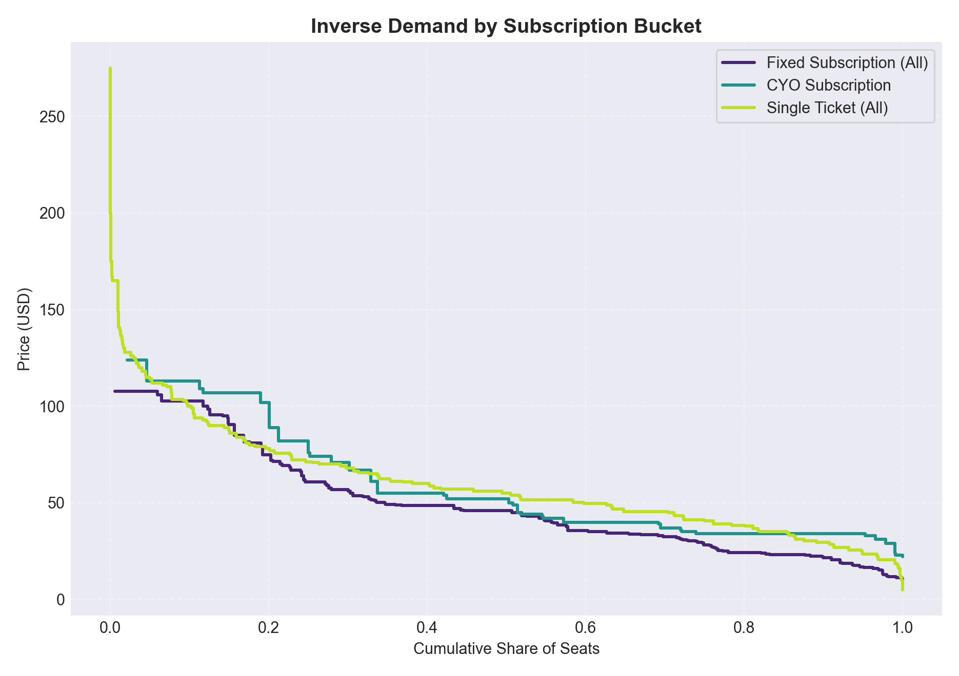
Demand for Subscribers and Single-Ticket Buyers
Notes:
Combined graph that Mialon asked for
CYO Subscriptions (inverse_demand_cyo_subscription.*): sits between fixed and single tickets (~\$57 avg). More price dispersion than fixed, but still relatively inelastic; focus on bundling rather than steep increases.
Fixed Subscriptions (inverse_demand_fixed__*.png and inverse_demand_fixed_subscription_(all).*):
Established / Sophomore / Upgrade cohorts show near-flat curves between \$40–\$65—little observed resistance due to limited price tests; great for premium upsells.
Freshman and Balcony-oriented packages are more elastic; keep price steady or bundle perks instead of raises.
Single Ticket Buyer

Slide 38
Demand by Event Type

Slide 39
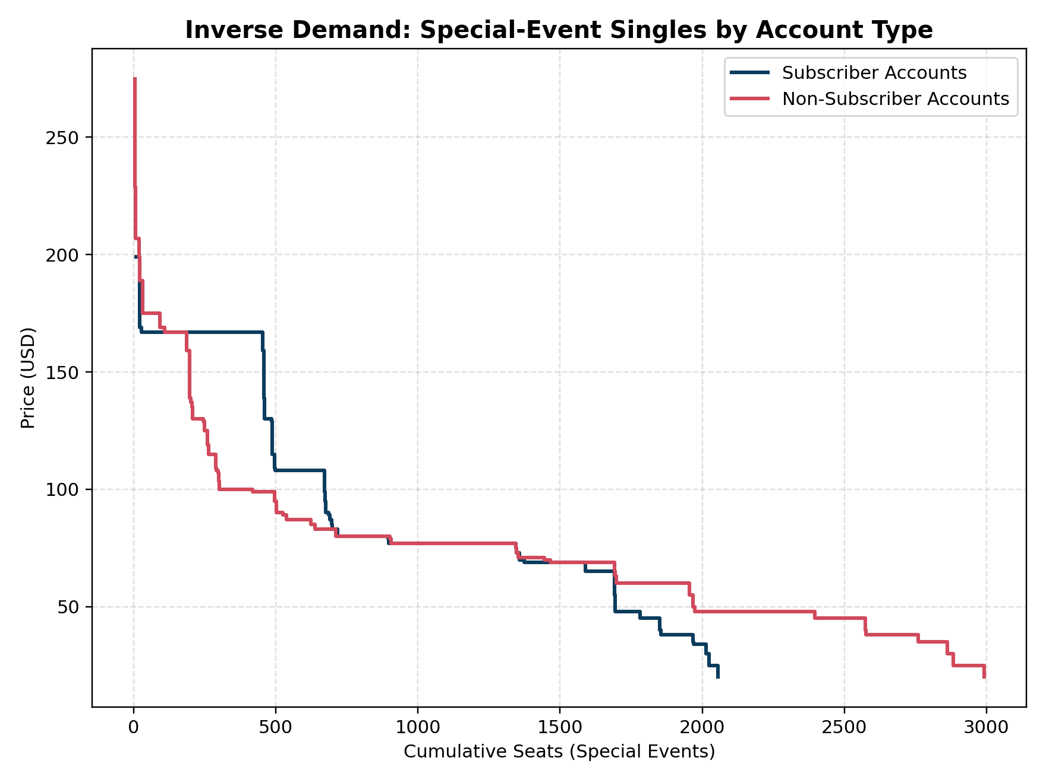
Demand for Special Events
Notes:
Special-event demand splits cleanly between subscriber accounts and non-subscribers: subscribers buy roughly 2k seats at predictable price tiers (~\$90 average, rarely above \$200), so their inverse-demand curve drops steeply beyond \$150 and behaves almost inelastic—ideal for modest (≤10%) price lifts bundled with member perks. Non-subscribers, by contrast, cover nearly 3k seats across the full \$25–\$275 range; their curve slopes gradually, revealing high elasticity (≈‑1.5) and strong responsiveness to both premium tranches and late-stage discounts. Together, the curves indicate that ASO should maintain stable, access-focused pricing for subscribers while using dynamic pricing for non-subscribers to capture peak willingness-to-pay and clear remaining inventory

Slide 40
Pricing
Analysis based on simulated price changes/strategy implementation.

Slide 41
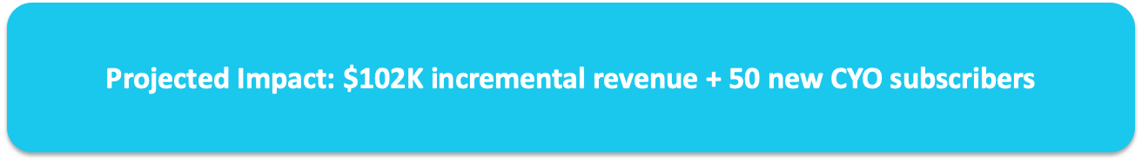
Overview of Simulations
New product: Discounted Classical tickets for Special/Holiday single ticket buyers
Target market: 7,008 accounts (30% of all single ticket buyers)
80.6% of these buyers have NEVER purchased a Classical ticket
Product differentiation protects existing pricing - no cannibalization risk
Creates a pipeline for CYO subscription conversion
Notes:
The Classical Add-On Product is a strategic initiative to convert our Special and Holiday event attendees into Classical series customers.
Here's what makes this opportunity compelling:
- It's based on PROVEN demand patterns in our data
- It protects our existing pricing through product differentiation
- It creates a pipeline to our CYO subscription program
- It's low-risk because we're creating a NEW product, not discounting existing ones
Let me walk you through the data, the product design, and the projected impact.
KEY POINTS TO EMPHASIZE:
1. THE PRODUCT: We're offering discounted Classical tickets ONLY to people who attended Special or Holiday events. This is a targeted loyalty reward, not a general discount.
2. MARKET SIZE: 7,008 accounts - this is 30% of all our single ticket buyers. It's a substantial audience.
3. THE UNTAPPED OPPORTUNITY: Here's the key insight - 80.6% of these Special/Holiday buyers have NEVER bought a Classical ticket. That's over 5,600 accounts who already love ASO but haven't tried our core Classical programming.
4. WHY PRODUCT DIFFERENTIATION MATTERS: We're not discounting Classical tickets broadly. The discount is ONLY available to verified Special/Holiday ticket holders. Regular Classical pricing remains intact. If someone wants to buy Classical at full price, they still can.
5. THE CYO PIPELINE: This isn't just about selling tickets. When we convert someone to 3+ Classical events, they become prime candidates for CYO subscription. Our historical data shows 24.6% conversion rate.
BOTTOM LINE: $102K incremental revenue plus 50 new CYO subscribers.

Slide 42
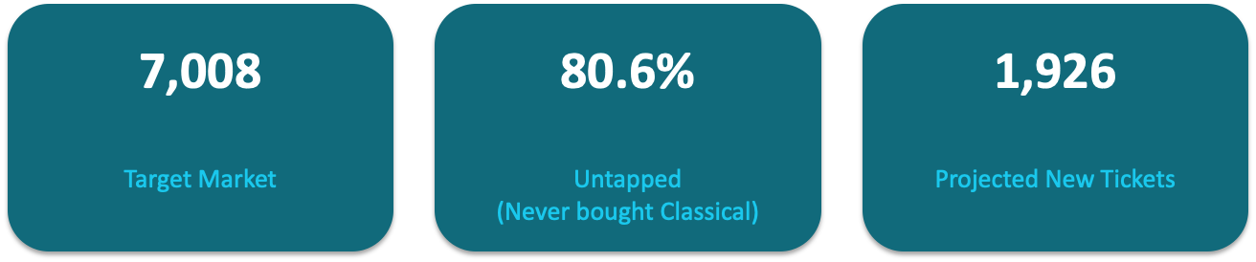
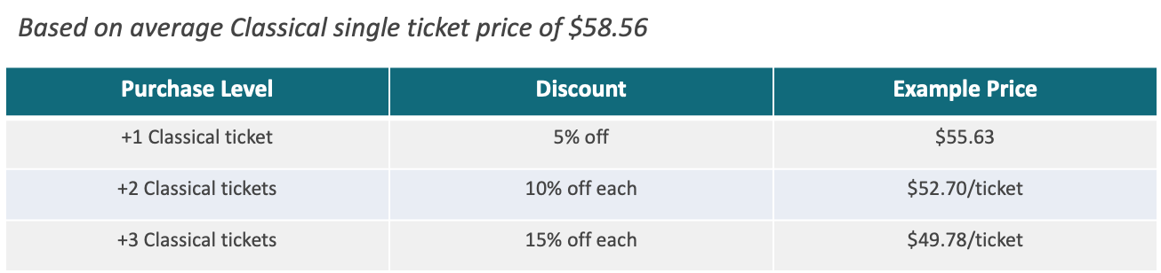
Key Opportunity Metrics
Discount Structure
Notes:
TALKING THROUGH THE NUMBERS:
7,008 TARGET ACCOUNTS:
- These are single ticket buyers who attended Special or Holiday events in FY23-FY24
- They've already demonstrated they enjoy ASO - they chose to attend our premium events
- They represent 30% of all single ticket accounts
- This is a WARM audience, not cold outreach
80.6% NEVER BOUGHT CLASSICAL:
- This is the remarkable insight that drives the entire strategy
- 5,647 accounts attended Special/Holiday but have never tried Classical
- They're not anti-Classical; they just haven't been given a compelling reason to try it
- The add-on product gives them that reason: a discount tied to an event they already enjoyed
1,926 PROJECTED NEW TICKETS:
- Based on conservative 20% response rate assumptions
- Mix of +1, +2, and +3 ticket purchases
- Each ticket is incremental - these are sales that wouldn't happen otherwise
KEY TRANSITION: Let me show you how the discount structure works...
DISCOUNT STRUCTURE EXPLAINED:
The discount is CUMULATIVE - meaning it applies to ALL tickets at the highest tier reached:
+1 TICKET (5% off):
- Entry-level option for cautious first-timers
- Price: $55.63 (saves $2.93)
- Low commitment, easy yes
+2 TICKETS (10% off EACH):
- Both tickets get the 10% discount
- Price: $52.70 per ticket = $105.40 total (saves $11.72)
- Encourages bringing a friend/partner
+3 TICKETS (15% off EACH):
- All three tickets get the 15% discount
- Price: $49.78 per ticket = $149.34 total (saves $26.34)
- This is our target because 3+ Classical buyers convert to CYO at 24.6%
WHY CUMULATIVE?
- Rewards higher commitment
- Simple to understand
- Creates clear incentive to buy more
- Average discount across our projections: ~9.5%
IMPORTANT: This discount is ONLY available to verified Special/Holiday ticket holders. Regular Classical pricing ($58.56 average) remains unchanged for everyone else.

Slide 43
Marketing: Why Same-Day Offers Matter
Peak Emotional Engagement: Customers are at highest satisfaction post-concert
Brand Association: Memory of event is fresh, Classical feels like natural continuation
Reduced Decision Friction: Already demonstrated willingness to spend on ASO
Social Proof: Group decisions more likely in the moment
60-day validity window creates urgency while allowing time to plan
Notes:
THE PSYCHOLOGY OF TIMING:
This slide is CRITICAL for execution. The WHEN matters as much as the WHAT.
PEAK EMOTIONAL ENGAGEMENT:
- Right after a Special or Holiday concert, customers are on a high
- They just had a wonderful experience with ASO
- This is the moment they're most receptive to "more of this"
- Waiting even 24-48 hours means the emotional peak fades
BRAND ASSOCIATION:
- "You loved Holiday Pops, now experience Beethoven's 9th"
- The connection feels natural, not salesy
- We're extending their positive experience, not interrupting them later
REDUCED FRICTION:
- They're already in "ASO mode"
- Credit card was just used (mental accounting)
- The decision to spend on ASO has already been made today
- Adding Classical feels like an extension, not a new decision
SOCIAL PROOF:
- If they're with friends/family, group purchases are more likely
- "Should we try the Classical series?" - easier to decide together in the moment
60-DAY VALIDITY:
- Long enough to plan around schedules
- Short enough to create urgency
- Matches our typical advance purchase window for this segment

Slide 44
Top Gateway Classical Events
These events have proven appeal to Special/Holiday crossover buyers
Event Name | Crossover Buyers | Total Seats | Revenue
Beethoven Symphony No 9 | 188 | 427 | $29,067
Opening Weekend | 164 | 327 | $21,503
Orff: Carmina Burana | 139 | 287 | $22,903
Beethoven and Bolero | 119 | 351 | $22,351
Bizet and Tchaikovsky | 115 | 329 | $16,811
Notes:
DATA-DRIVEN EVENT RECOMMENDATIONS:
This table shows which Classical events our Special/Holiday buyers ALREADY gravitate toward when they do cross over. These are our "gateway" concerts.
BEETHOVEN SYMPHONY NO 9 (188 crossover buyers):
- The most popular Classical event among our target audience
- Familiar, accessible, emotionally powerful
- "You don't need to know Classical to love the 9th"
- Should be prominently featured in all add-on marketing
OPENING WEEKEND (164 crossover buyers):
- Appeals to those who like "events" not just concerts
- Special occasion feel matches Special/Holiday vibe
- Good for first-timers who want a memorable experience
ORFF: CARMINA BURANA (139 crossover buyers):
- Dramatic, theatrical, accessible
- Appeals to the Special event crowd
- "You'll recognize O Fortuna"
BEETHOVEN AND BOLERO (119 crossover buyers):
- Mix of familiar pieces
- Bolero is highly recognizable
- Good entry point
BIZET AND TCHAIKOVSKY (115 crossover buyers):
- Carmen and Nutcracker excerpts
- Familiar melodies
- Holiday audience particularly responsive
MARKETING IMPLICATION: Feature these events prominently in the add-on offer. "Based on your ticket to Holiday Pops, we recommend Beethoven's 9th..."

Slide 45
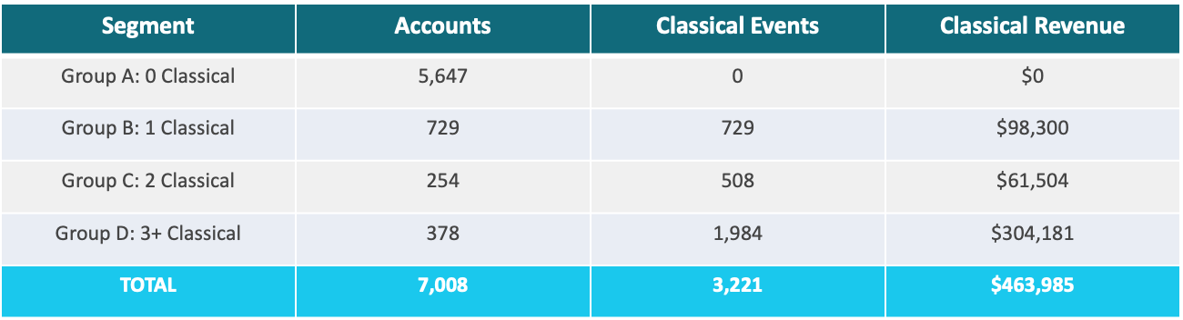
Current State: Special/Holiday Single Ticket Buyers
Notes:
UNDERSTANDING THE SEGMENTS:
GROUP A - NEVER BOUGHT CLASSICAL (5,647 accounts):
- This is 80.6% of our target market
- They attended Special/Holiday events
- But they've NEVER purchased a Classical ticket
- This is our PRIMARY conversion target
- Huge untapped potential
GROUP B - BOUGHT 1 CLASSICAL (729 accounts):
- They've tried Classical once
- Opportunity to upsell to 2 or 3 tickets
- Already curious, need a push
GROUP C - BOUGHT 2 CLASSICAL (254 accounts):
- Regular crossover behavior
- One more ticket gets them to 3+
- One more ticket puts them in CYO conversion territory
GROUP D - BOUGHT 3+ CLASSICAL (378 accounts):
- Already engaged in Classical series
- Prime candidates for CYO subscription NOW
- 24.6% historical conversion rate
- Not our add-on target, but our CYO target
THE OPPORTUNITY:
- Group A alone represents $0 in Classical revenue today
- Converting even 20% of Group A to one ticket each = 1,129 new tickets
- That's why this program focuses heavily on Group A

Slide 46
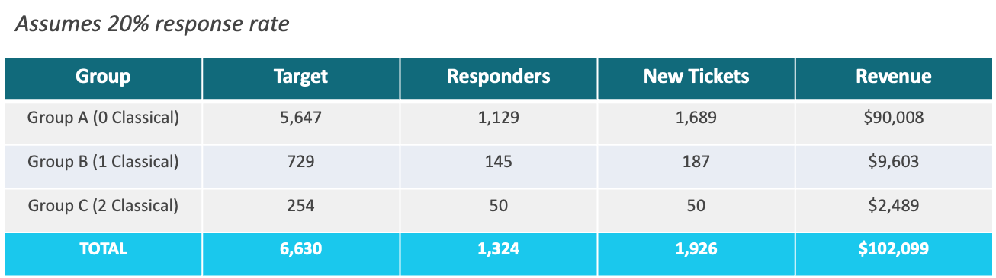
Projected State: With Add-On Program
Notes:
PROJECTED UPTAKE EXPLAINED:
ASSUMPTIONS:
- 20% response rate (conservative for targeted, same-day offers)
- Industry benchmarks suggest 15-30% for highly relevant offers
- We're being conservative
GROUP A PROJECTIONS:
- 5,647 accounts × 20% response = 1,129 responders
- Distribution: 60% buy +1, 30% buy +2, 10% buy +3
- Results in 1,689 new tickets
- Revenue: $90,008 (after discounts)
- This is the bulk of our opportunity
GROUP B PROJECTIONS:
- 729 accounts × 20% = 145 responders
- Buying 1-2 more tickets to reach 2 or 3 total
- 187 new tickets
- Revenue: $9,603
GROUP C PROJECTIONS:
- 254 accounts × 20% = 50 responders
- Each buying 1 more to reach 3 total
- 50 new tickets
- Revenue: $2,489
TOTAL IMPACT:
- 1,324 accounts respond to the offer
- 1,926 new Classical tickets sold
- $102,099 in incremental revenue
WHY THIS IS CONSERVATIVE:
- Same-day offers typically see higher response rates
- We're targeting a warm audience (they already attend ASO)
- Benefits are clear and immediate

Slide 47
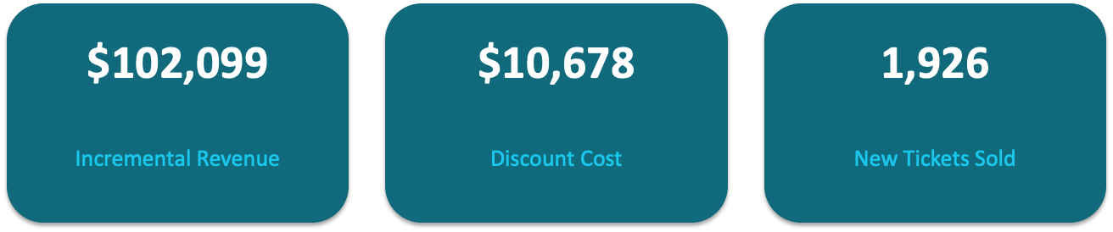
Financial Impact
Notes:
FINANCIAL SUMMARY:
$102,099 INCREMENTAL REVENUE:
- This is NET revenue after discounts
- Every dollar is incremental - these are sales that wouldn't happen otherwise
- Compare to: current Classical revenue from this segment is $463K
- Add-on adds 22% to their Classical spending
$10,678 DISCOUNT COST:
- This is the difference between discounted price and full price
- Represents 9.5% average discount across all purchases
- But remember: these buyers weren't going to buy at full price anyway
- The "cost" is theoretical - the revenue is real
1,926 NEW TICKETS:
- Each ticket represents a new Classical experience for a Special/Holiday buyer
- Many of these are first-time Classical attendees
- Potential for repeat purchases in future seasons
- Foundation for CYO subscription conversion
ROI PERSPECTIVE:
- Marketing cost to implement: minimal (email, signage)
- Revenue generated: $102,099
- Plus downstream CYO conversions worth $20-30K annually
- This is a high-ROI initiative

Slide 48

CYO Subscription Conversion Potential
Historical data: 24.6% of 3+ Classical buyers convert to CYO
Program creates 205 new accounts reaching 3+ Classical tickets
Projected new CYO subscribers: 50 accounts
Estimated CYO revenue impact: $20,000 - $30,000 per season
This is RECURRING revenue beyond the initial add-on purchase
Notes:
THE CYO CONVERSION PIPELINE:
This is where the strategy gets really powerful. The add-on isn't just about selling tickets - it's about building a subscriber pipeline.
HISTORICAL CONVERSION DATA:
- We analyzed single ticket buyers who reached 3+ Classical events
- 24.6% of them converted to CYO subscription
- This is a proven pathway to subscription
NEW 3+ CLASSICAL BUYERS FROM THIS PROGRAM:
- Group A buying +3: 112 accounts
- Group B buying +2 more (total 3): 43 accounts
- Group C buying +1 more (total 3): 50 accounts
- TOTAL: 205 new accounts reaching 3+ Classical
PROJECTED CYO CONVERSIONS:
- 205 accounts × 24.6% conversion rate = 50 new CYO subscribers
- This is a conservative estimate
CYO REVENUE IMPACT:
- Average CYO subscription value: $400-600/season
- 50 subscribers × $400-600 = $20,000-$30,000 per season
- This is RECURRING revenue
- Subscribers tend to renew at 70-80% rates
THE BIGGER PICTURE:
- Year 1: $102K ticket revenue + customer acquisition
- Year 2+: 50 new CYO subscribers × $400-600 = ongoing revenue
- Plus those CYO subscribers may upgrade further
- The add-on product is a funnel top, not just a revenue line

Slide 49
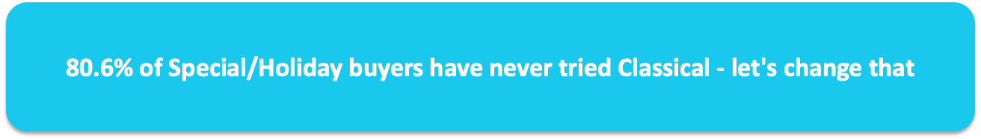
Conclusion
Low-risk, high-potential opportunity
Converts 1,324 Special/Holiday buyers into Classical attendees
Generates $102,099 in incremental revenue from 1,926 new tickets
Creates pipeline of 50 new CYO subscribers worth $20K-$30K/season
Preserves pricing integrity through product differentiation
Notes:
CLOSING SUMMARY:
Let me leave you with the key points:
1. LOW-RISK, HIGH-POTENTIAL:
- We're not discounting existing products
- We're creating a new, targeted offer
- If it doesn't work, we adjust without affecting core business
2. CLEAR TARGET, PROVEN DEMAND:
- 7,008 accounts who already love ASO
- 80.6% have never tried Classical
- We're not creating demand; we're unlocking it
3. STRONG FINANCIAL CASE:
- $102,099 incremental revenue year one
- 1,926 new ticket sales
- ~9.5% average discount cost
4. STRATEGIC CYO PIPELINE:
- 205 new accounts reaching 3+ Classical
- 50 projected CYO conversions
- $20-30K recurring annual revenue
5. PRICE INTEGRITY PROTECTED:
- Product differentiation, not discounting
- Exclusive to verified ticket holders
- Full-price Classical remains unchanged
THE ASK:
Approve the pilot program for the next 2-3 Special/Holiday events. We'll measure results, optimize, and scale based on data.
The opportunity is clear. 80.6% of Special/Holiday buyers have never tried Classical. Let's change that.
ADDRESSING RISK CONCERNS:
This slide is critical for stakeholder buy-in. Let me address common concerns:
"WON'T THIS CANNIBALIZE FULL-PRICE SALES?"
No, because:
- The discount is ONLY available to verified Special/Holiday ticket holders
- General public cannot access this pricing
- If someone wants to buy Classical at full price, they still can
- We're targeting people who WEREN'T buying Classical anyway
"WHAT IF IT DOESN'T WORK?"
- The add-on is a separate product
- If it underperforms, we adjust or discontinue
- Our core Classical pricing remains unchanged
- No damage to existing business
"WILL THIS DEVALUE OUR CLASSICAL SERIES?"
- Positioning is crucial: "loyalty reward" not "discount"
- It's exclusive to a specific audience
- Actually ELEVATES Classical by introducing new audiences
- Similar to airline miles or hotel loyalty perks
"HOW DO WE CONTROL WHO GETS THE OFFER?"
- Ticket purchase verification required
- Unique codes tied to specific accounts
- Cannot be shared or transferred
- Clear terms and conditions
"WHAT IF DISCOUNT LEVELS ARE WRONG?"
- Start with pilot (2-3 events)
- A/B test different discount levels
- Adjust based on response data
- We have control to optimize

Slide 50

Fixed Plus
Target: Fixed 6 subscribers – ASO's core subscription base (1,643)
Insight: 57.8% already purchase additional single tickets (proven demand)
Product: Premium bundle with Holiday/Special event access at 10% premium
Strategy: Sell BENEFITS, not price – advance access, guaranteed seating status
Revenue: $40,741 projected from 354 Fixed Plus subscribers
Notes:
KEY POINTS TO EMPHASIZE:
1. TARGET MARKET: Fixed 6 is our largest subscription tier - 1,643 accounts representing 70% of all Fixed subscribers. These are committed patrons, not casual attendees.
2. THE INSIGHT: Here's what's remarkable - nearly 58% of these subscribers ALREADY go out of their way to buy additional single tickets. They're telling us with their behavior: "We want more than 6 concerts."
3. THE PRODUCT: Fixed Plus bundles what they already want - Holiday and Special event access - at a 10% premium. But we don't lead with price...
4. THE STRATEGY: We lead with BENEFITS. Priority access. Guaranteed seating. VIP status. The 10% premium feels justified when you're getting exclusive perks.
5. THE OPPORTUNITY: Conservative projections show $40,741 from just 354 subscribers - and this is a foundation we can build on.

Slide 51
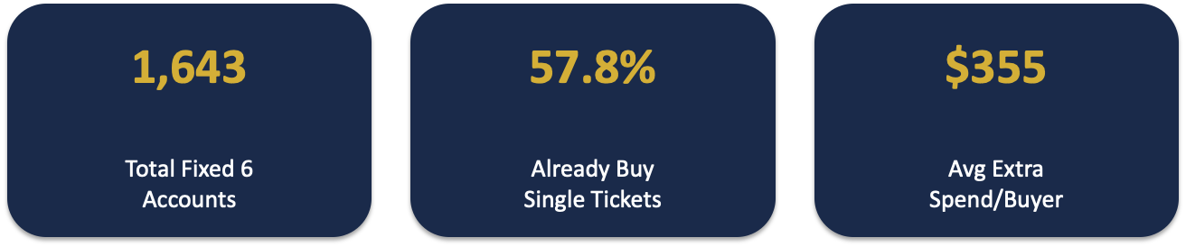
The Opportunity: Fixed 6 Subscribers
Fixed 6 Single Ticket Behavior
Event Type | Unique Buyers | Total Seats | Revenue
Classical | 709 | 3,274 | $208,590
Special | 381 | 951 | $82,806
Holiday | 196 | 708 | $41,980
Notes:
TALKING THROUGH THE NUMBERS:
Let me put these three numbers in context:
1,643 ACCOUNTS: This is a substantial base. Fixed 6 is our "gateway" subscription - serious enough to commit to 6 concerts, but not the heavy users who buy 18 or 24. They're the middle of the funnel.
57.8%: This is the critical insight. More than half of these subscribers are already buying additional single tickets on top of their subscription. They've demonstrated willingness to spend more with us. The question is: are we making it easy for them?
$355 AVERAGE: Among those who buy extra, they're spending $355 on average. That's significant incremental revenue per customer. And they're doing this despite friction - having to monitor ticket sales, compete for seats, go through separate checkout. Imagine if we removed that friction.
TRANSITION: Let's look at exactly what they're buying...
ANALYZING THE DATA:
This table shows what Fixed 6 subscribers are buying as single tickets:
CLASSICAL ($208K): The largest category - 709 unique buyers purchasing Classical single tickets. This makes sense: their subscription is Classical-focused, and they want MORE Classical. This validates demand but isn't our Fixed Plus target.
SPECIAL ($82K): Here's where it gets interesting. 381 accounts - nearly a quarter of all Fixed 6 subscribers - bought Special event single tickets. These are premium experiences they're seeking out.
HOLIDAY ($42K): 196 accounts bought Holiday tickets. These events often sell out, creating urgency and FOMO.
THE INSIGHT: Combined, over 500 Fixed 6 accounts are buying Holiday and Special single tickets. That's the exact demand Fixed Plus is designed to capture - but with added benefits and at a premium price.
KEY QUESTION TO POSE: Why are we making our best customers compete with the general public for these seats?

Slide 52

What Fixed 6 Subscribers Want
MORE EVENTS: 57.8% buy additional single tickets (avg. 2.5 events)
PLAN AHEAD: 45% purchase 2+ months in advance – advance access is valuable
PREMIUM SEATING: 83% of subscriptions are in premium sections
QUALITY: Average single ticket spend per buyer is $355 in a season – willing to pay for value
CONVENIENCE: They're already doing extra work to buy more tickets
Notes:
BUILDING THE CASE - WHAT THE DATA TELLS US:
Let me translate these behaviors into customer needs:
1. MORE EVENTS: They're not satisfied with 6 concerts. The average extra buyer attends 2.5 additional events. They want a deeper relationship with ASO.
2. PLAN AHEAD: This is crucial for Fixed Plus design. 45% of their single ticket purchases happen 2+ months before the event. These are planners, not impulse buyers. "Priority Access" isn't just marketing fluff - it's something they genuinely value.
3. PREMIUM SEATING: 83% of their subscriptions are in Orchestra or Loge sections. They're not bargain hunters. They choose quality and are willing to pay for it.
4. WILLING TO PAY: $355 average spend on extras. These aren't price-sensitive customers looking for the cheapest option.
5. CONVENIENCE: Think about what they're doing now - monitoring on-sale dates, competing for seats, going through separate purchases. They're doing this despite friction. What if we removed that friction and added VIP perks?
THE BOTTOM LINE: Fixed 6 subscribers are telling us what they want through their behavior. Fixed Plus is simply packaging it better.
TRANSITION:
Now that we've established the demand exists - and it clearly does - let me show you how Fixed Plus is designed to meet that demand while capturing premium revenue.
The key principle here is PRODUCT DIFFERENTIATION. We're not discounting. We're not cannibalizing. We're creating a new premium tier that delivers genuine value.

Slide 53
The Solution: Fixed Plus
Notes:
TRANSITION:
Now that we've established the demand exists - and it clearly does - let me show you how Fixed Plus is designed to meet that demand while capturing premium revenue.
The key principle here is PRODUCT DIFFERENTIATION. We're not discounting. We're not cannibalizing. We're creating a new premium tier that delivers genuine value.

Slide 54
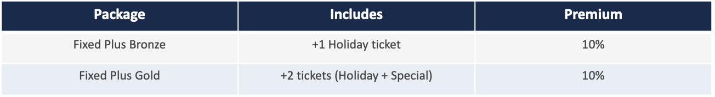
Fixed Plus Package Options
Notes:
PRODUCT STRUCTURE:
We're offering two tiers to capture different levels of demand:
FIXED PLUS BRONZE:
- Adds 1 Holiday ticket to their subscription
- 10% premium over regular single ticket price
- Entry-level option for those who want to "try" the program
- Price: approximately $62.61 (vs $56.92 regular)
FIXED PLUS GOLD:
- Adds 2 tickets: 1 Holiday + 1 Special event
- 10% premium on both
- For the more engaged subscriber who wants the full experience
- Price: approximately $150.53 total
WHY 10% PREMIUM?
- High enough to capture meaningful revenue
- Low enough to feel justified by the benefits
- Positions as "premium" without feeling exploitative
TIMING IS KEY: We offer this at subscription renewal - when they're already in "buying mode" and thinking about their ASO commitment for the year. It's a natural upsell moment.
ACCESS BENEFITS - THE CORE VALUE PROPOSITION:
These three benefits are the foundation of Fixed Plus. They solve real problems our subscribers face:
PRIORITY ACCESS WINDOW (2 weeks early):
- Remember: 45% of Fixed 6 buyers purchase 2+ months in advance
- They're planners who want certainty
- Two weeks early access means they get first pick of dates and seats
- Creates genuine exclusivity
GUARANTEED SEAT HOLDS:
- 83% sit in premium sections for their subscription
- When buying single tickets, they risk not getting comparable seats
- Fixed Plus guarantees their preferred section is available
- Removes the anxiety of "will I get good seats?"
SELLOUT PROTECTION:
- Holiday events often sell out
- Nothing is more frustrating than wanting to attend and being shut out
- This benefit uses LOSS AVERSION psychology - avoiding the pain of missing out
- Frame it as: "Never miss a Holiday concert again"
These aren't invented benefits - they directly address friction points we see in the data.

Slide 55
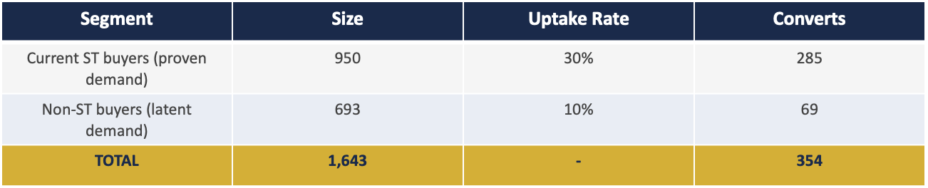
Target Segments and Uptake
Notes:
UPTAKE ASSUMPTIONS EXPLAINED:
We're targeting two segments with different expected conversion rates:
SEGMENT 1: CURRENT SINGLE TICKET BUYERS (950 accounts)
- These are Fixed 6 subscribers who ALREADY buy extra tickets
- They've demonstrated the behavior we're trying to capture
- 30% uptake assumption is reasonable because:
- They already want what we're offering
- We're adding benefits (priority access, convenience)
- We're removing friction (single checkout)
- 30% of 950 = 285 expected converts
SEGMENT 2: NON-SINGLE TICKET BUYERS (693 accounts)
- These Fixed 6 subscribers haven't bought extras YET
- Could be due to friction, awareness, or lower interest
- 10% uptake assumption is conservative because:
- They haven't shown the behavior
- But benefits might unlock latent demand
- "Sellout protection" might appeal to FOMO
- 10% of 693 = 69 expected converts
TOTAL: 354 Fixed Plus subscribers
WHY THESE RATES ARE CONSERVATIVE:
- Industry benchmarks for subscription upsells: 15-40%
- Our benefits directly address documented pain points
- Upside potential if marketing resonates

Slide 56
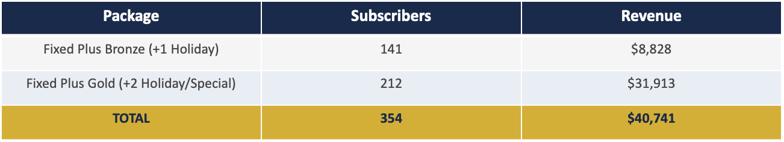
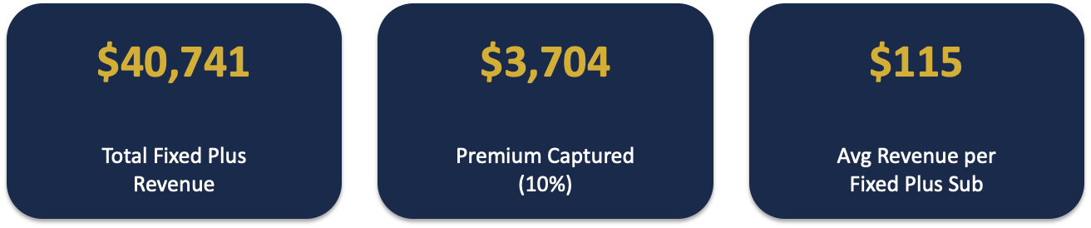
Projected Revenue
Notes:
REVENUE BREAKDOWN:
PACKAGE MIX ASSUMPTION:
- 40% choose Bronze (entry-level, 1 Holiday ticket)
- 60% choose Gold (fuller experience, 2 tickets)
- This mix is based on typical tiered pricing behavior: most choose the middle/premium option when benefits are clear
BRONZE REVENUE: $8,828
- 141 subscribers × $62.61 (Holiday at 10% premium)
- Entry point for cautious buyers
- Many may upgrade to Gold in year 2
GOLD REVENUE: $31,913
- 212 subscribers × ~$150.53 (Holiday + Special at 10% premium)
- The "sweet spot" offering
- Higher value, higher engagement
TOTAL: $40,741
- First-year revenue from Fixed Plus program
- Remember: this is INCREMENTAL - either new revenue or premium capture
- Foundation for growth in subsequent years
IMPORTANT CONTEXT: This is conservative. If we achieve 40% uptake among ST buyers instead of 30%, that's an additional $13,500+ in revenue.
FINANCIAL SUMMARY:
Three numbers to remember:
$40,741 TOTAL REVENUE:
- This is what Fixed Plus generates in year one
- For context: if these customers bought the same tickets at regular price, we'd get $37,037
- Fixed Plus adds both volume AND margin
$3,704 PREMIUM CAPTURED:
- This is the pure premium - the 10% above regular pricing
- This is revenue we would NOT have captured otherwise
- Relatively small in year one, but grows with program scale
- Also: doesn't account for customers who wouldn't have bought at all
$115 AVERAGE REVENUE PER SUBSCRIBER:
- Each Fixed Plus member generates $115 in add-on revenue
- Compare to: current average of $355 for those who buy ST (but only 57.8% do)
- Fixed Plus captures more people at a more predictable rate
THE BIGGER PICTURE:
- Year 1: $40,741 (354 subscribers)
- Year 2 with 90% renewal + new: potentially $60K+
- Year 3 with Platinum tier: $80K+
- This is a foundation for sustainable growth

Slide 57
Why this works
BUNDLING: Bundles feel like better value than buying separately
LOSS AVERSION: 'Sellout Protection' = avoiding loss (powerful motivator)
STATUS: 'Fixed Plus Member' appeals to identity and belonging
COMMITMENT: Once a 'Plus' member, more likely to renew & upgrade
CONVENIENCE: Single checkout removes friction that blocks purchases
Notes:
BEHAVIORAL ECONOMICS BEHIND FIXED PLUS:
Let me explain WHY these design choices work psychologically:
BUNDLING EFFECT:
- Research shows customers perceive bundles as better value
- Even at the same total price, "package" feels like a deal
- Fixed Plus positions tickets + benefits as integrated offering
LOSS AVERSION (most powerful):
- Psychologically, avoiding a loss is 2x more motivating than achieving a gain
- "Sellout Protection" = avoiding the PAIN of missing out
- "Priority Access" = avoiding the FRUSTRATION of bad seats
- We're not selling tickets; we're selling peace of mind
STATUS & IDENTITY:
- "Fixed Plus Member" creates an identity
- People act consistently with their self-image
- Once they see themselves as a "Plus member," they behave like one
- Recognition in programs reinforces this identity
COMMITMENT & CONSISTENCY:
- Once someone upgrades to Fixed Plus, they're invested
- They'll want to "get their money's worth" from benefits
- Renewal becomes natural - they've already self-identified as Plus members
CONVENIENCE PREMIUM:
- People pay more for convenience (Amazon Prime, priority boarding)
- Single checkout removes decision fatigue
- Friction is the enemy of conversion

Slide 58
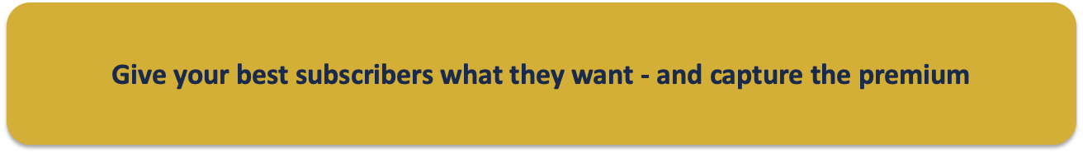
Conclusion
Fixed 6 subscribers are loyal but UNDERSERVED
57.8% already buy extra tickets – demand is proven
Fixed Plus meets them with bundled convenience + VIP benefits
10% premium is justified by exclusive access & experience
Projected: 354 subscribers, $40,741 revenue, pathway to expand
Notes:
CLOSING SUMMARY:
Let me leave you with five key takeaways:
1. THE OPPORTUNITY IS REAL
Fixed 6 subscribers are our most loyal yet underserved segment. They've told us through their behavior that they want more.
2. THE DEMAND IS PROVEN
57.8% already buy single tickets. We're not creating demand; we're packaging it better.
3. THE PRODUCT IS DESIGNED FOR THEM
Fixed Plus isn't a generic upsell. Every benefit addresses a specific pain point we identified in the data: advance planning, seat quality, convenience.
4. THE PREMIUM IS JUSTIFIED
10% is modest when you're getting priority access, guaranteed seating, sellout protection, and VIP status. We're not gouging; we're delivering value.
5. THE NUMBERS WORK
354 subscribers, $40,741 year-one revenue, with a clear pathway to grow through renewals, upgrades, and premium tiers.
THE ASK: Approve the pilot program targeting our 950 single-ticket-buying Fixed 6 subscribers at their next renewal cycle.
The worst case: We learn and adjust.
The best case: We build a sustainable premium revenue stream while deepening relationships with our most valuable patrons.
Questions?
ADDRESSING POTENTIAL CONCERNS:
CANNIBALIZATION RISK:
Q: "Won't this just shift revenue we would have gotten anyway?"
A: Two scenarios, both positive:
Scenario 1 - They would have bought single tickets anyway:
- Now they pay 10% premium
- We capture extra margin on inevitable purchases
- Net positive
Scenario 2 - They wouldn't have bought:
- Fixed Plus unlocks demand that friction was blocking
- 100% incremental revenue
- Net positive
There's no scenario where we lose.
OPERATIONAL CONCERNS:
Q: "How do we manage priority access inventory?"
A: Start conservatively:
- Hold 5% of Holiday/Special capacity for Fixed Plus
- Monitor demand and adjust
- If underutilized, release to general sale
- Simple ticketing system flag
BENEFIT DELIVERY:
Q: "Can we actually deliver on pre-concert talks, lounge access?"
A: Phase the benefits:
- Year 1: Focus on ACCESS benefits (easy to deliver)
- Year 2: Add EXPERIENCE benefits (as program proves itself)
- Year 3: Premium tier with exclusive experiences
- Don't over-promise; build credibility gradually

